Slide 1

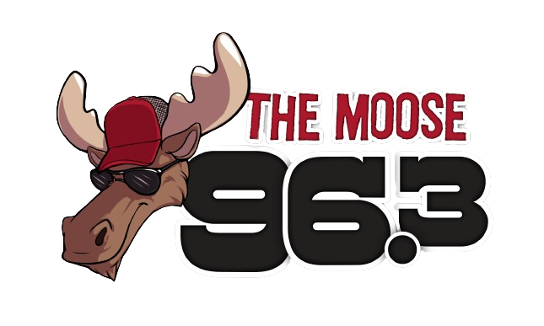
MEDIA KIT
OHANA MEDIA GROUP

Slide 2

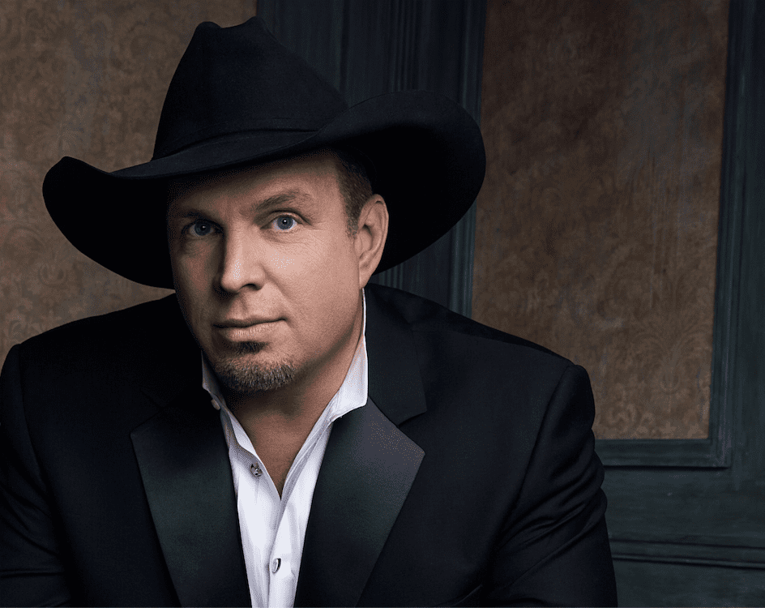
KXLW 96.3 FM
  96.3 The Moose is the ultimate destination for modern country music in Anchorage, Alaska.
  With an extensive playlist featuring the latest hits from top country artists, we capture the essence of the genre and keep our listeners engaged.
  Our passionate on-air personalities bring a genuine love for country music, connecting with our loyal audience through relatable stories, artist interviews, and exciting promotions.
  KXLW 96.3 is the go-to station for country music enthusiasts, providing a platform for advertisers to reach a dedicated and engaged audience.

Slide 3
KXLW 96.3 FM
Engaging and Influential Personalities:
Our on-air personalities have a strong influence on our audience. They connect with listeners on a personal level, creating a unique bond that extends to the brands they endorse. By partnering with our stations, you can leverage the influence and rapport our personalities have with their dedicated fan base, effectively promoting your products or services.
Five reasons why advertising on Ohana Media Radio Stations in Anchorage Alaska Works
3
Extensive Reach:
Ohana Media Group's radio stations have a wide and loyal listener base, ensuring that your message reaches a large and diverse audience in Anchorage, Alaska. With a variety of formats, we can target specific demographics and cater to different interests, maximizing the potential reach of your advertising campaign.
Targeted Advertising Opportunities:
Ohana Media Group offers targeted advertising opportunities that allow you to reach specific demographics or interest groups. Whether you want to target country music lovers, rock enthusiasts, or the adult contemporary audience, our diverse range of stations ensures that your message is delivered to the right people at the right time, maximizing the effectiveness of your campaign.
1
4
Deep Local Connection:
Ohana Media Group's radio stations have deep-rooted connections within the local community. Anchorage residents trust and rely on our stations for news, entertainment, and music. By advertising on our platforms, you tap into this strong local connection and build brand credibility, fostering trust and loyalty among consumers.
Multi-Channel Approach:
Ohana Media Group's radio stations provide a multi-channel approach to advertising. In addition to on-air commercials, we offer digital advertising options on our social media platforms. This multi-channel approach allows for broader exposure, reaching audiences across different mediums and increasing the chances of reaching your target audience multiple times, reinforcing your brand message.
2
5

Slide 4

KXLW 96.3 FM
TARGET AUDIENCE
25-64
56%
44%
Our target audience ranges from 25-64 yearl old adults
56% of our audience is comprised of male listeners
44% of our audience is comprised of female listeners

Slide 5

KXLW 96.3 FM FEATURES
  Moose Music Mornings with Eddie Maxwell - (The 2023 ABA Broadcaster of the year, lol. That and a buck 50 might get you a cup of coffee) less talk more 90s country and information with Eddie
  The 90s @ Noon with Brad - Nothing but 90s country 12n-1p with deeper 90s hits
  Big Don on the Ride Home, 3-7 - Big Don keeps you entertained and informed on the ride home, with plenty of Alaska’s 90s country and more!
  The Stories that made the music - A neat one minute “story” about country artists! airs 3 times per day, Mon-Fri!
  Fishing Report - Paul Reed, the master angler, tells us where the fishing’s hot and where it’s not! airs 4 times per day, Thursday thru Saturday.

